Slide 1



BIA 660-B WEB MINING
Credit Card Benefits Comparison Dashboard​

Slide 2

CONTENT
01
PROBLEM STATEMENT
02
GOALS AND OBJECTIVES
03
DATA AND DATA COLLECTION
04
EDA
05
ARCHITECTURE
06
RESULTS
07
CONCLUSION

Slide 3




Problem Statement
Analyze user sentiment around different credit card features through user reviews available on the internet
Address the difficulty faced by consumers when choosing a credit card service by providing a Recommendation Dashboard

Slide 4





GOALS AND OBJECTIVES
Objective n° 1
Objective n° 2
Objective n° 3
Data Collection:-
Scrape Data From online forums such as WalletHub
Use pre-compiled dataset for training
Analyze reviews through sentiment analytics
Use machine learning algorithms to build a recommender system which helps consumers make informed decisions

Slide 5

DATA DESCRIPTION
Reviews
Includes reviews from consumers posted for various credit card services.
Credit Card Info
Includes card specific information such as Transfer APR, Regular APR, Annual Fee, Rewards Rate, Bonus Offers etc.

Slide 6

DATA COLLECTION
Compiled Dataset
Scrapped Reviews
Scrapped Card Info
Dataset obtained from Kaggle
Over 7500 entries with information such as card name, category, ratings, reviews, source, bank, etc.
Scrapped reviews from WalletHub using BeautifulSoup Library
Includes text reviews from consumers
Lables are assiciated with reviews in the form of card name
Scrapped information from WalletHub using BeautifulSoup Library
Includes card specific information for 17 distinct Credit Card Services.

Slide 7

RECOMMENDOR
Data Preprocessing
Removing Duplicates
Combining Features
TF-IDF Feature Matrix Creation
Recommender Function
Based on Card Name
Based on Card Category

Slide 8
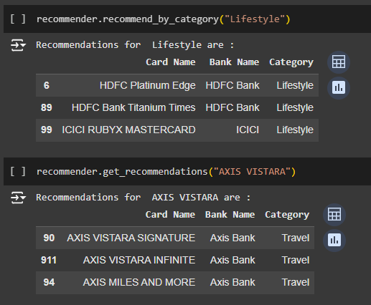
TOP RECOMMENDATIONS

Slide 9
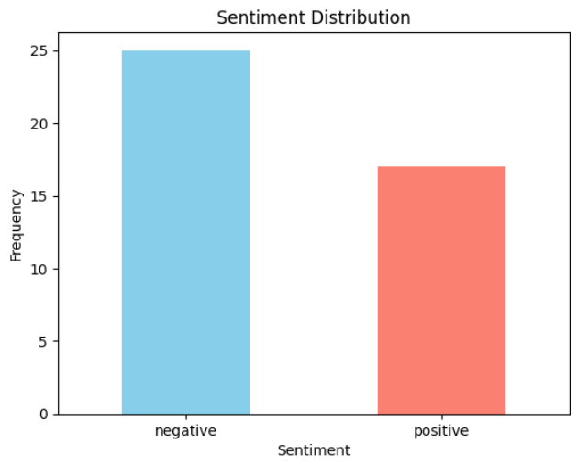
SENTIMENT ANALYSIS
BERT (Bidirectional Encoder Representations from Transformers) used for sentiment classification.
Results:
Positive Sentiments: 59.52%.
Negative Sentiments: 40.48%.

Slide 10
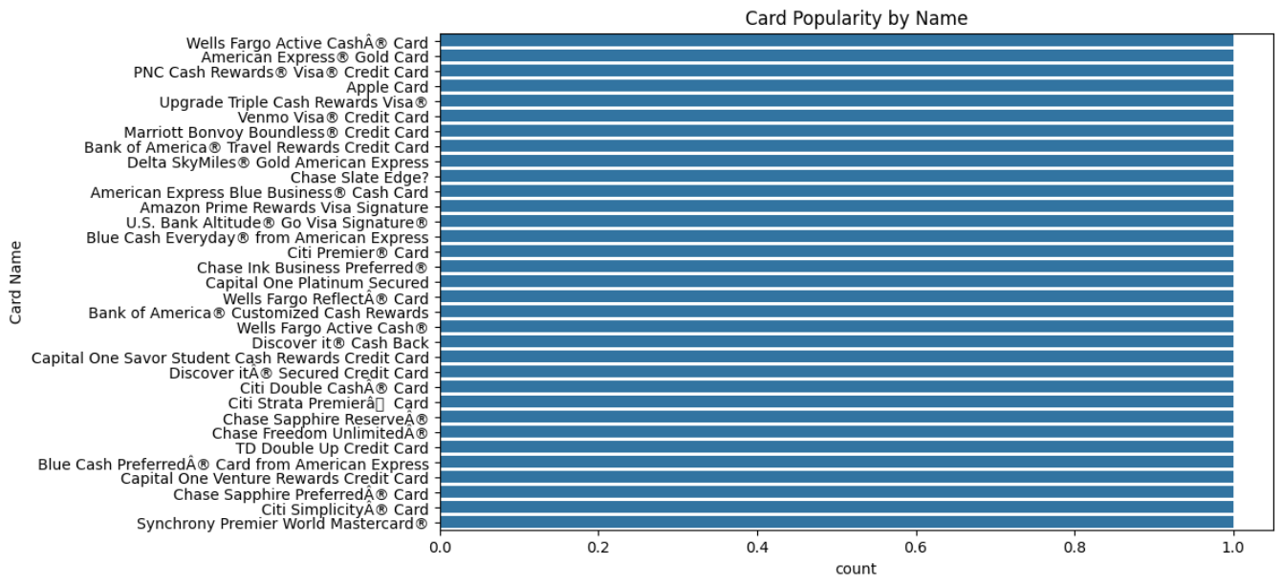
EDA INSIGHTS

Slide 11
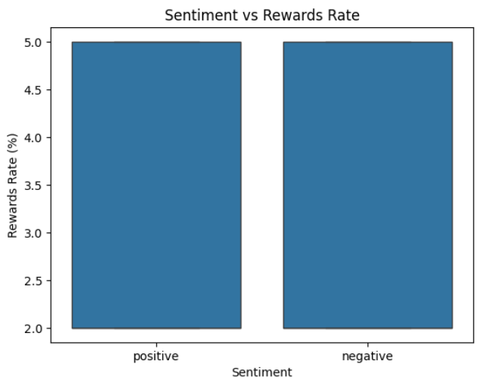
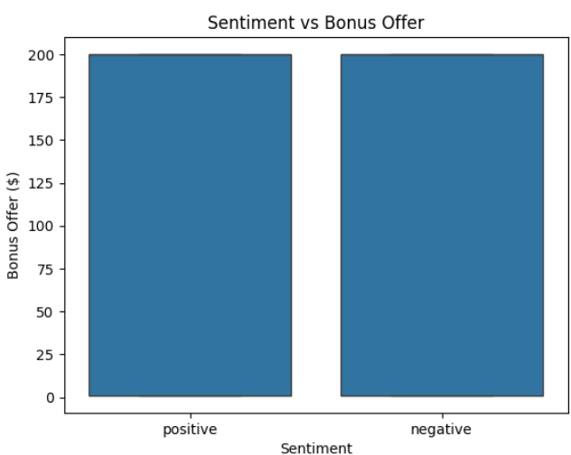
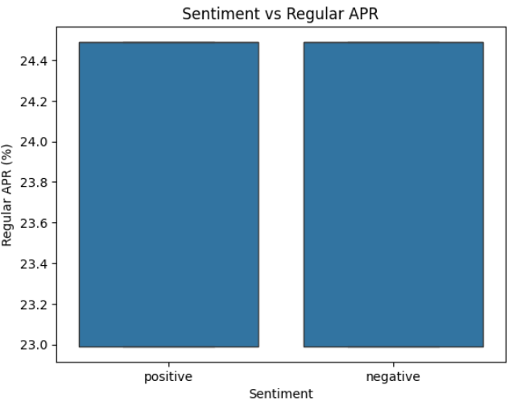
EDA INSIGHTS
Key Findings
Rewards Rate: User sentiment does not significantly differ between 2% and 5% rewards rates.
Bonus Offer: Cards with $200 bonuses show equal sentiment distribution, indicating minimal influence on satisfaction.
Regular APR: No strong correlation between APR values and user sentiment.

Slide 12
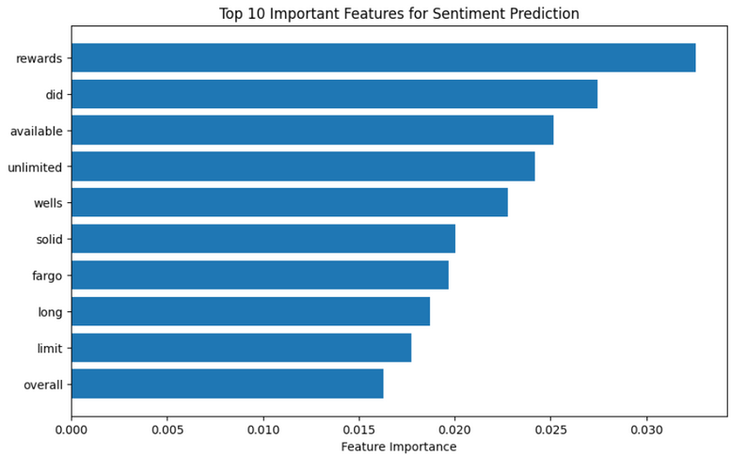
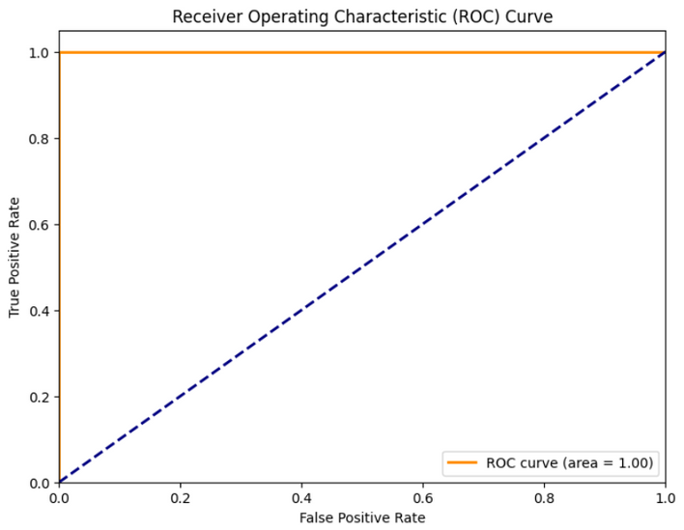
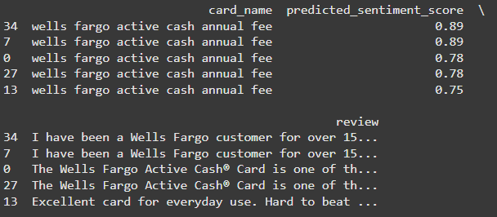
RECOMMENDATION BASED ON REVIEWS
Random Forest Classifier.
Process Overview:
Data Preprocessing
Model
Sentiment Prediction
Key Results:
Model Performance (accuracy 78%, f1 75-80%)
Top Features
Top 5 Recommended Cards

Slide 13
CONCLUSION
Impact:
Demonstrated how online reviews can guide user-focused recommendations.
Highlighted the role of sentiment analysis in understanding consumer needs.
Future Scope:
Incorporate personalized recommendations.
Expand datasets for more diverse insights.

Slide 14

THANK
YOU

